Slide 1
Transmission’s Critical Role in Decarbonizing New England:
Improving electric transmission planning, investment and siting
Sue Tierney
Senior Advisor, Analysis Group
New England Electricity Restructuring Roundtable
September 24, 2021
Notes:
RI

Slide 2
Electric transmission analysis and planning
Transmission’s role in decarbonizing New England’s economy

Slide 3
New England High-Voltage Transmission System: 2009
New England High-Voltage Transmission System: 2021
The region’s transmission system: fit for purpose yesterday and today, from a reliability and economic efficiency point of view.
Unlikely to be fit for purpose going forward, given the states’ decarbonization policies.
New England 2030 Power System Study: Preliminary Maps and Cost Estimates for Potential Transmission; ISO-NE Planning Advisory Committee; August 14, 2009.
ISO-New-england-geographic-diagram-transmission-planning.pdf
Notes:
9,000 miles of high-voltage transmission lines (115 kV and above)
13 transmission interconnections to power systems in New York and Eastern Canada
$10.9 billion invested to strengthen transmission system reliability since 2002

Slide 4
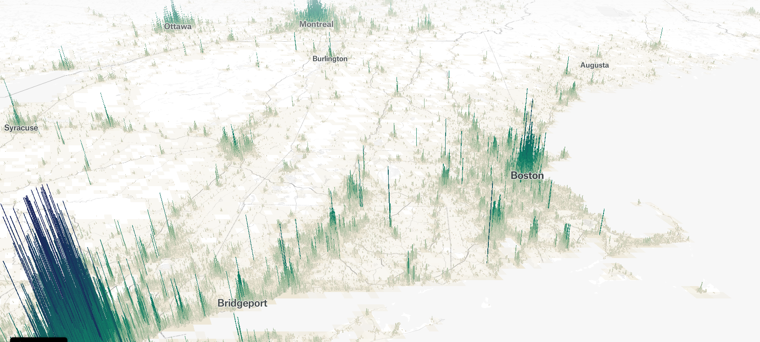
Canadian Hydro
Onshore Wind & Solar
New England and Neighboring Regions:
Landscape of change as the region decarbonizes
state with clean energy mandate
Population Density
Pressure on expansion of electric loads with electrification.
Pressure to expand the size of regions for diverse loads and resources
Solar
Solar
Solar
Pressure on long-distance transmission to connect remote renewables with loads
Pressure on timing and character of loads with distributed energy resources
Offshore Wind
https://pudding.cool/2018/10/city_3d/
Notes:
CT = 100% clean electricity by 2040
ME = 100% clean energy by 2050
MA = net zero by 2050
RI = 100% renewable by 2030

Slide 5

ISO-NE’s current Public Policy Transmission Upgrade process isn’t fit for purpose in terms of regional transmission planning to support the states’ accomplishment of their decarbonization policies.
New England should shift toward a more robust scenario-analysis planning process, embedding states’ energy/electricity policies at the center of the development of scenarios for building out the system.
The scenario studies need to characterize and anticipate multiple pathways and look for robust transmission solutions that help enable different strategies.
FERC’s Transmission ANOPR anticipates the kinds of changes in planning that are needed ahead.
https://www.publicpower.org/periodical/article/most-good-beneficial-transmission-planning

Slide 6
Decision-Making and Cost Allocation for Electricity Transmission
Transmission’s role in decarbonizing New England’s economy

Slide 7

The states need a more formal seat at the table
It’s time to more actively a FERC-approved governance provisions for ISO-NE, in light of:
States’ clean energy policies that compel the accelerated entry of lower carbon resources
Federal jurisdiction over wholesale markets and transmission
Example of FERC-approved role for the states in an RTO’s governance:
Southwest Power Pool’s Regional State Committee

Slide 8
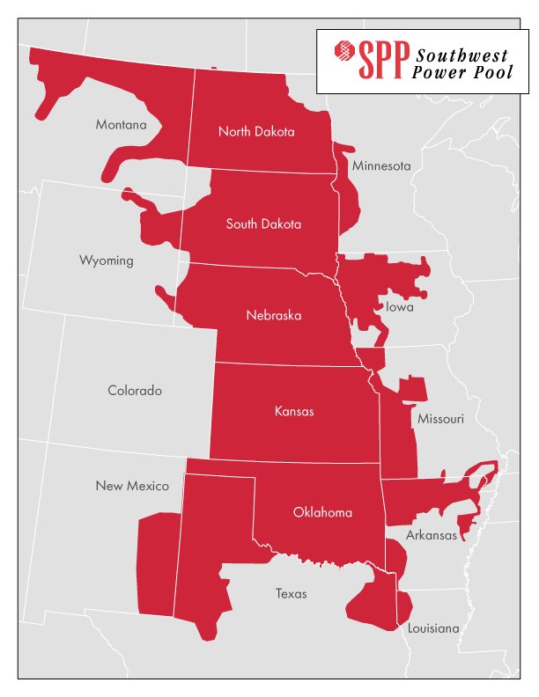
SPP’s Regional State Committee
Primary responsibility for determining regional proposals on:
Any participant funding for transmission enhancements.
Structure of regional transmission access charge (e.g., license plate, postage stamp).
Other transmission cost-allocation issues.
Also responsible for determining and filing at FERC (under §205):
The approach for resource adequacy across the region.
Whether transmission upgrades for remote resources will be included in the regional transmission planning process.
The role of transmission providers in making proposals.

Slide 9
Siting and permitting of electric transmission projects
Transmission’s role in decarbonizing New England’s economy

Slide 10

Today’s transmission siting process is also not fit for purpose today
State jurisdiction over transmission siting has always been tough.
The past decades show us that:
Single-state transmission projects are easier to site than multi-state projects.
It’s relatively easy to site/permit projects if the solutions are proposed to solve a reliability problem.
It’s much less easy to site and permit transmission project designed to solve congestion and save consumers money.
It’s much, much harder to site and permit if the purpose is to connect remote, out-of-state clean energy resources with distant load centers.

Slide 11


Recommendations of the National Academies’ reports on the Future of the US Electric System and on Decarbonizing the U.S. Energy System
The Future of Electric Power in the US (2021)
The current federal/state jurisdictional framework over transmission siting is not working, given national (and state) needs.
Reforms should include:
New Congressional policy to articulate the national interest in transmission for reliability, economic efficiency and access to clean energy.
National Interest Electricity Transmission Corridors should identify needs for transmission access to high value resources for low-carbon power supply.
Stronger authority for FERC in siting/ permitting projects in such corridors.
Accelerating the Decarbonization of US Energy System (2021)
https://www.nationalacademies.org/our-work/the-future-of-electric-power-in-the-us; https://www.nationalacademies.org/our-work/accelerating-decarbonization-in-the-united-states-technology-policy-and-societal-dimensions

Slide 12
Transmission for Offshore Wind
Transmission’s role in decarbonizing New England’s economy

Slide 13
My long-standing interest in strategic approaches to providing transmission access for offshore wind
Observation:
New England’s ability to meet its zero-carbon energy goals depends substantially on the efficient development of and access to offshore wind (among other resources).
Key chicken-and-egg problems persist in supporting onshore and offshore transmission for offshore wind projects.
Addressing these chicken-and-egg issues is key.

Slide 14
Example of state action to use transmission to enable development of offshore wind:
New Jersey’s Offshore Wind Transmission Needs in the PJM Context
Long-standing option under PJM tariff provisions to utilize a “State Agreement Approach” (“SSA”).
In 2021, NJ opted to pursue the competitive solicitation of onshore and offshore transmission project proposals to support the delivery of offshore wind energy under PJM’s SSA.
In September 2021, project proposals were due – and are now under review.
  Example of creative response to NJ’s Board of Public Utilities’/PJM OSW transmission solicitation: the Outerbridge Renewable Connector project.

Slide 15
Thank you
Susan Tierney, Ph.D.
Analysis Group
Susan.Tierney@analysisgroup.com
617- 425-8114

